Slide 1
Airbnb Newyork Analysis
.

Slide 2
Problem Statement of the Project
Real Estate Investment Firm’s Expansion into the Airbnb Market:
A real estate investment firm looking to expand into the Airbnb market in New York City. The firm wants to identify high-potential neighbourhoods, understand customer preferences, and design a pricing strategy that maximizes profits while ensuring customer satisfaction.
The firm has acquired a portfolio of residential properties across several NYC neighbourhoods, and they plan to list these properties on Airbnb. Before launching their listings, they need the analysis to make data-driven decisions on:
Optimal pricing per neighbourhood and room type.
Identifying the most active areas based on demand (availability, reviews).
Understanding customer preferences by analysing ratings and reviews.
Evaluating the competitive landscape by studying host performance.

Slide 3
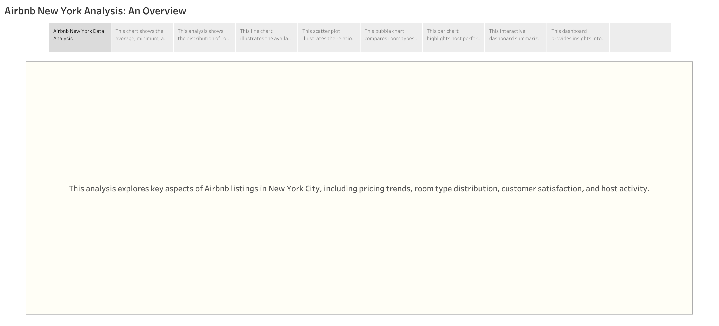

Slide 4
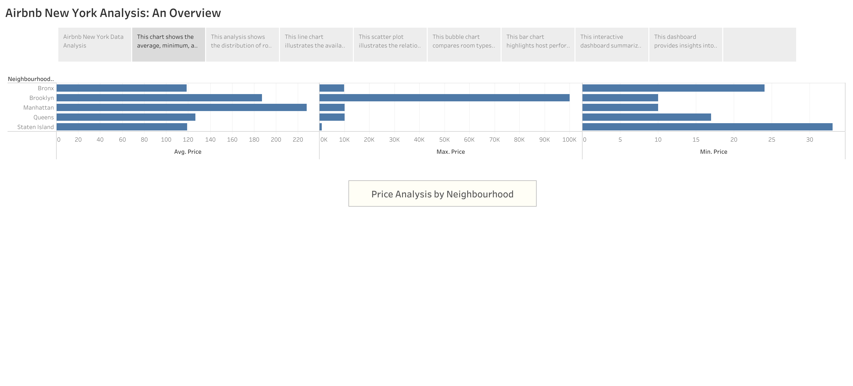
Data Organization: The pricing data was segmented by neighbourhood, with each neighbourhood grouped into categories. This allowed for a clear comparison across multiple price points—average, minimum, and maximum prices—offering a well-rounded view of the market.
How the Data Was Visualized:
The X-axis lists the neighbourhoods, while the Y-axis represents the price values.
The bars represent the average price, and additional bars show the minimum and maximum prices for more context.
What the Chart Depicts:
Neighbourhood Price Distribution: The chart reveals how prices vary significantly between neighbourhoods. For instance, Manhattan and Brooklyn show higher average prices compared to Queens or Staten Island. This suggests that the firm should prioritize investment in these premium areas where higher nightly rates can be charged.
Price Range: By showing the minimum and maximum prices alongside the averages, the chart also highlights the price flexibility within each neighbourhood. This can help the firm decide whether to list mid-range or luxury properties, depending on the price distribution.

Slide 5
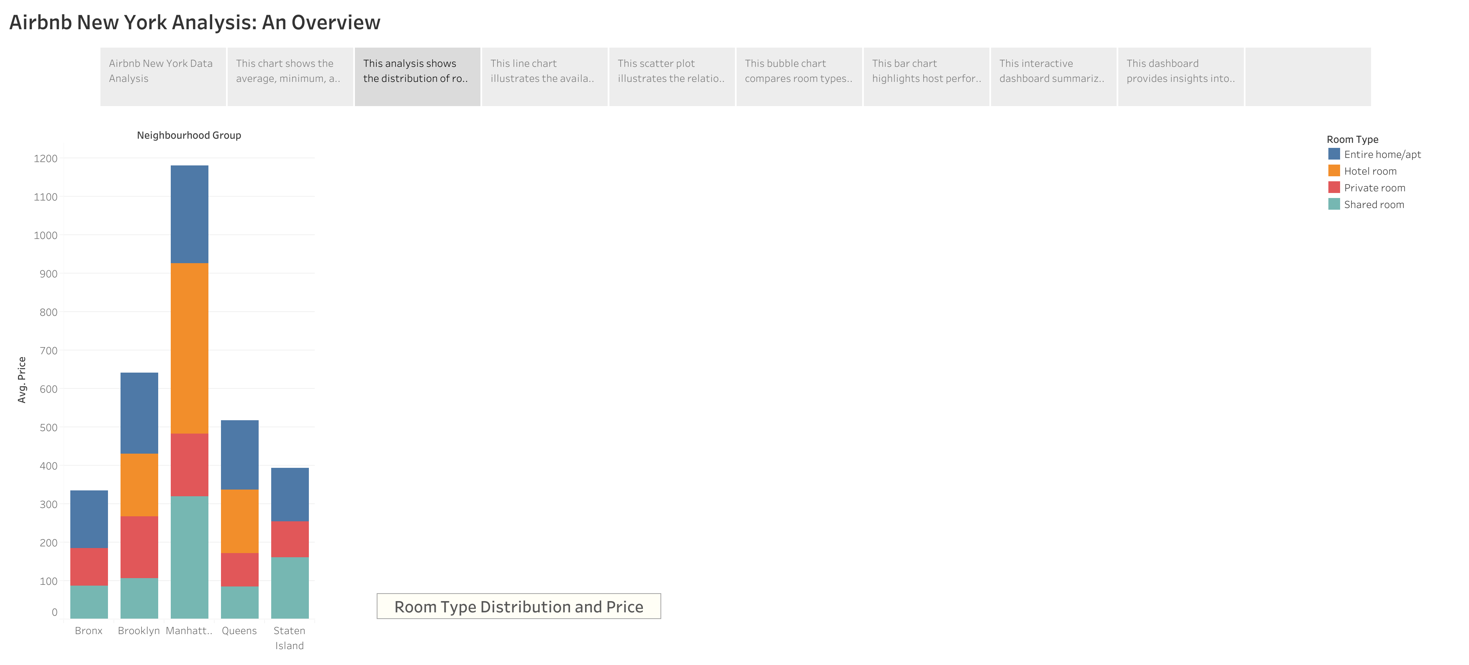
Data Organization:
The Room Type Distribution and Price chart uses a stacked bar graph to display the distribution of room types across neighbourhoods, along with their respective prices. This enables the firm to see which room types are more prevalent in certain neighbourhoods and how their prices compare.
The stacked bar chart visually breaks down room types within each neighbourhood and shows their pricing differences. This allows the firm to compare the relative popularity and pricing of entire homes, private rooms, and shared rooms.
What the Chart Depicts:
Room Type Prevalence: The chart shows that entire homes are generally priced higher and are more common in neighbourhoods like Manhattan and Brooklyn. Shared rooms, while cheaper, are less frequent in these premium areas.
Pricing Impact: Entire homes command significantly higher prices, making them more suitable for high-end clients. Private rooms offer a balance between affordability and comfort, while shared rooms attract budget travellers.
The firm should prioritize entire homes in high-demand neighbourhoods like Manhattan, where they can charge premium prices. Private rooms are a good option for mid-range pricing, while shared rooms might only be feasible in budget-friendly areas like Queens.

Slide 6
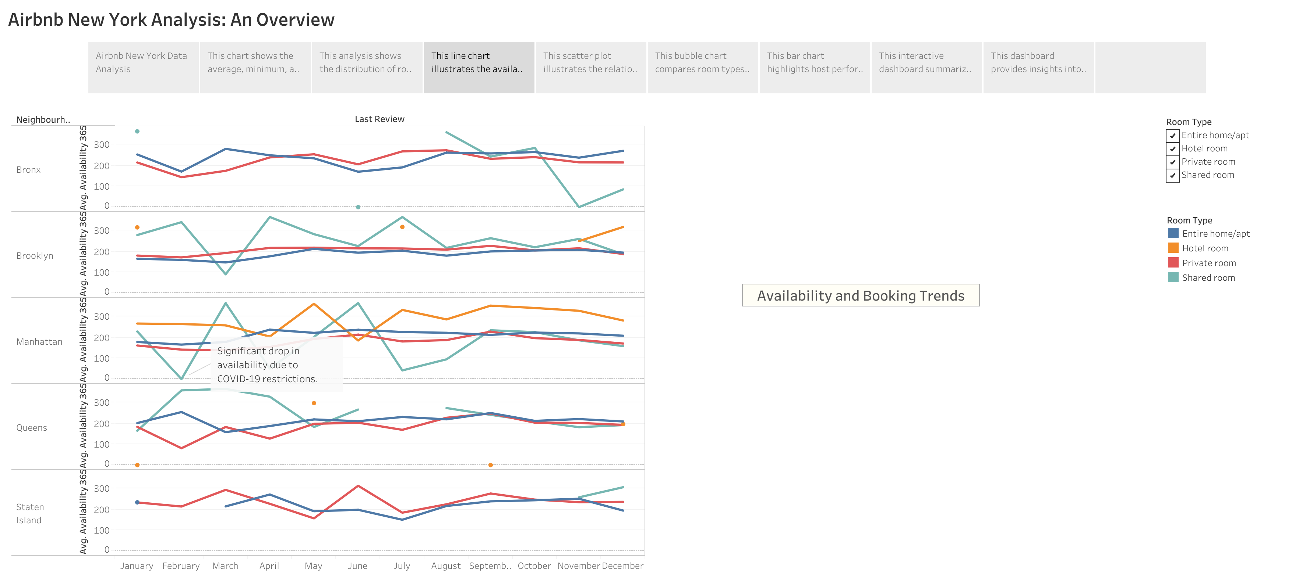
The Availability and Booking Trends chart uses a line graph to display how listings’ availability changes over time across different neighbourhoods. This helps the firm understand seasonal demand and the areas with the most consistent bookings.
What the Chart Depicts:
Consistent Availability: The chart shows that neighbourhoods like Manhattan and Brooklyn have high availability throughout the year, indicating strong and steady demand. Other neighbourhoods show more seasonal availability, with peaks during certain months.
Seasonal Trends: By identifying periods of high and low availability, the firm can plan when to open more listings in these high-demand areas.

Slide 7
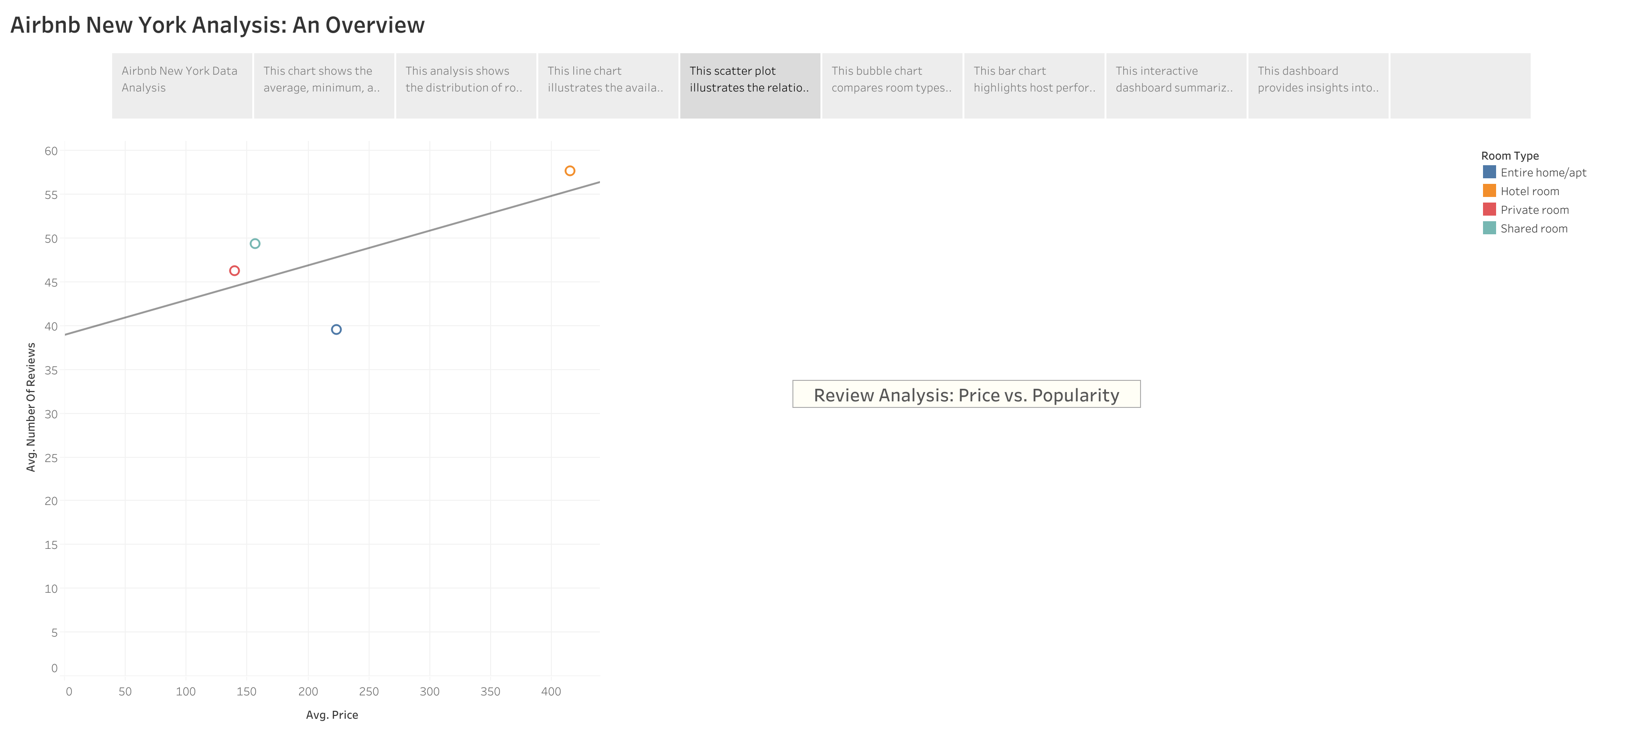
The Review Analysis (Scatter Plot) shows the relationship between the number of reviews and the listing price. This helps the firm understand how price influences popularity.
What the Charts Depict:
Review Insights: The scatter plot reveals that lower-priced listings tend to receive more reviews, suggesting that budget-conscious travellers are more likely to leave feedback. However, listings with higher prices, particularly entire homes, tend to have better ratings.

Slide 8
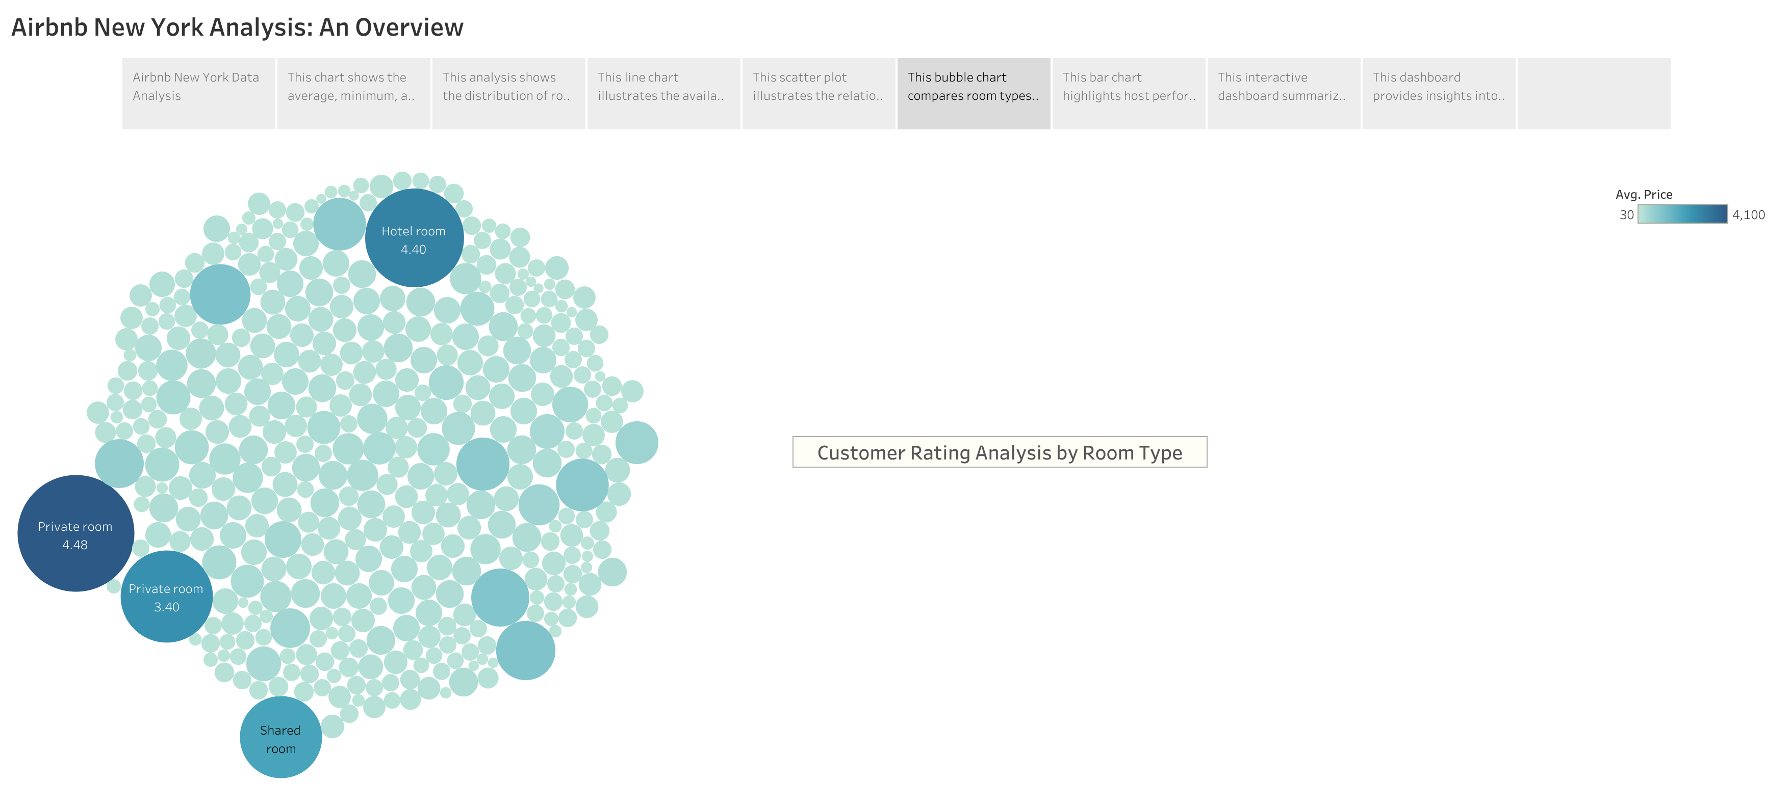
The Customer Rating Analysis (Bubble Chart) reveals how room types are rated, with larger bubbles representing listings with more reviews. This helps the firm identify which room types are most favoured by guests.
Rating Insights: The bubble chart shows that entire homes generally receive higher ratings compared to shared rooms, indicating a preference for more private, premium experiences.
Lower-priced listings can drive higher engagement, while entire homes can attract higher-end clientele with better ratings and overall satisfaction.

Slide 9
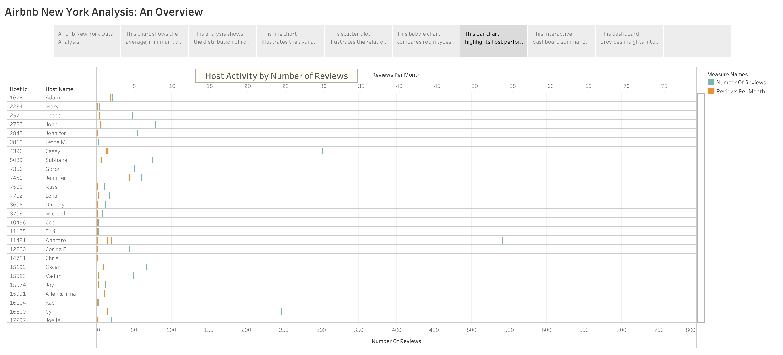
Top Hosts: The chart highlights hosts who have multiple listings and consistently receive high reviews in total and also in a month. These hosts are more active and successful, often managing multiple properties across neighbourhoods. The chart clearly shows the competitive landscape of top-performing hosts, giving the firm actionable insights on how to manage their listings and provide a superior guest experience.

Slide 10
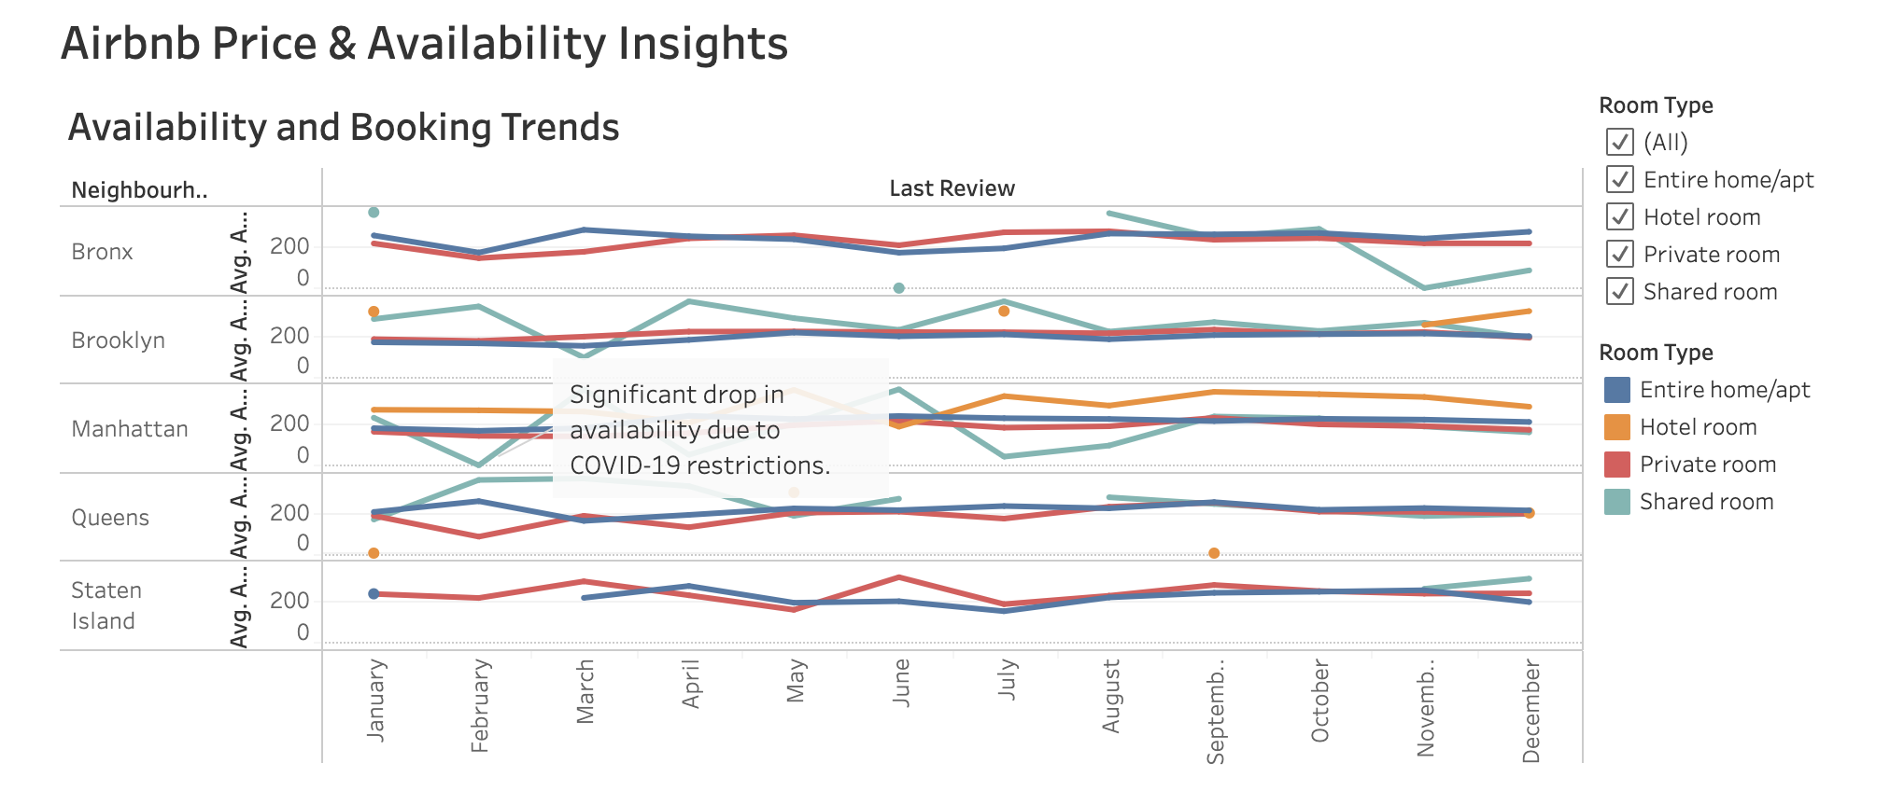
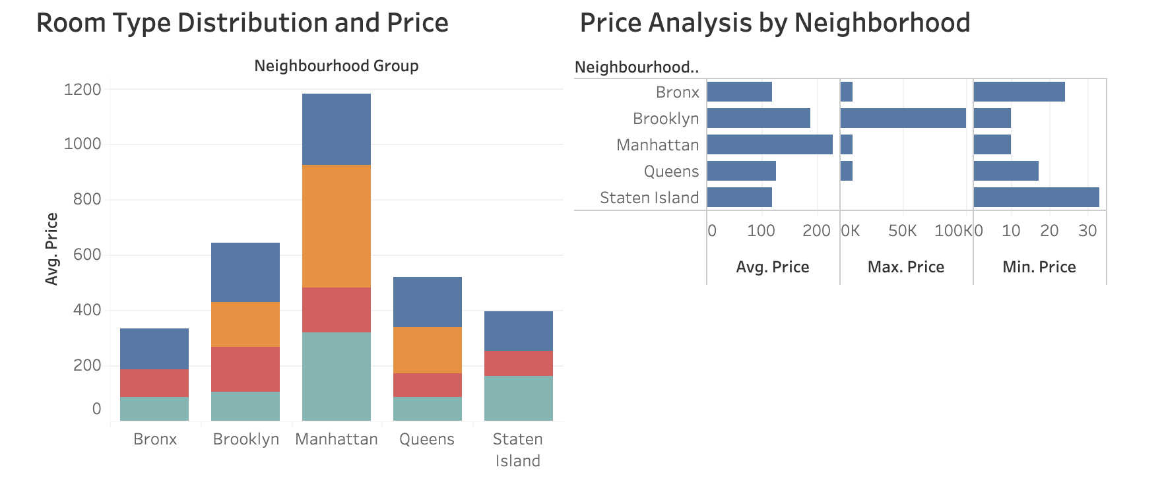
The Airbnb Price & Availability Insights Dashboard combines multiple metrics—pricing, availability, room types—into a single interactive view. This enables the firm to explore different scenarios and make data-driven decisions.
What the Dashboard Depicts:
Price and Availability Patterns: Users can filter by neighbourhood and room type to see how pricing and availability vary across different segments.
Real-Time Flexibility: The interactive nature allows the firm to explore various combinations of room types, neighbourhoods, and pricing strategies to optimize their investment.

Slide 11
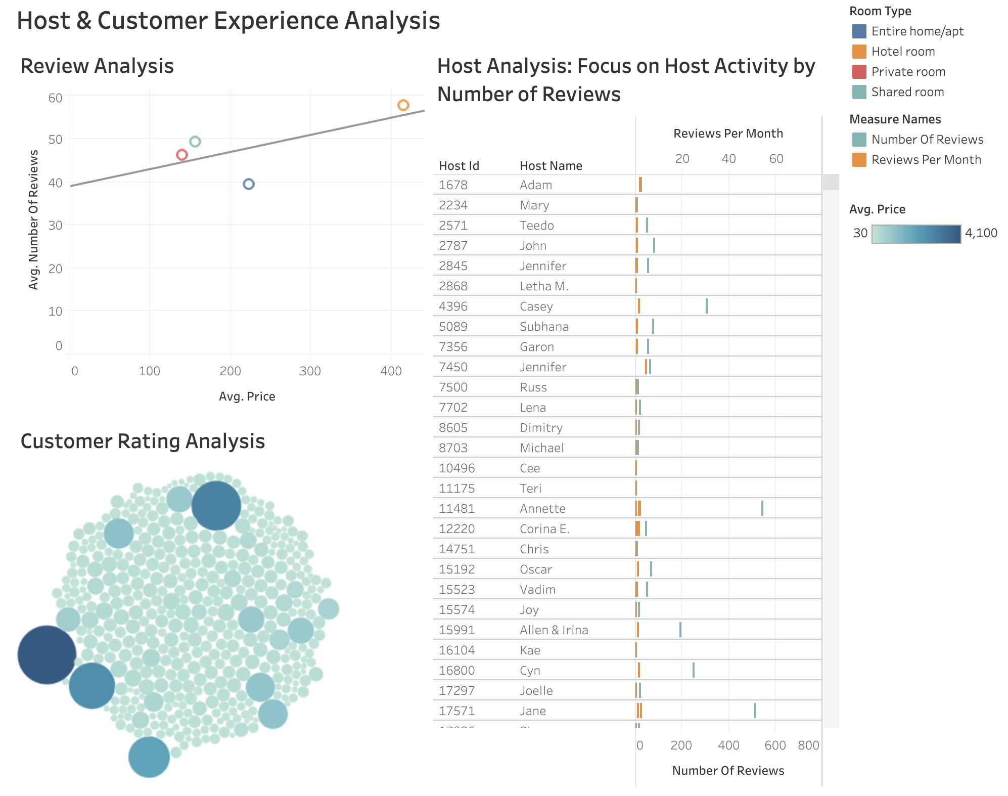
The Host & Customer Experience Dashboard combines insights into host activity and customer ratings, allowing the firm to benchmark against top hosts and adjust their strategy based on real-time data.
What the Dashboard Depicts:
Host Performance: the firm can compare their listings to top-performing hosts in terms of reviews and customer ratings.
Customer Satisfaction: The dashboard also shows how room types and pricing impact customer satisfaction, allowing the firm to make strategic adjustments.

Slide 12
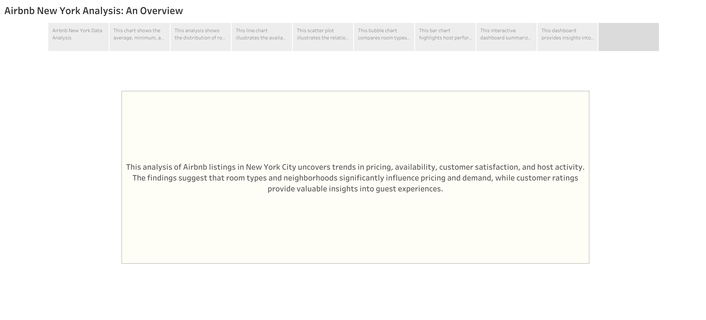
By focusing on high-demand areas, prioritizing entire home listings, and optimizing customer satisfaction, the firm can maximize profitability in the competitive New York Airbnb market.

